Slide 1
Line of Business: Typelists
08 September 2011
Notes:
Line of Business: Typelists - <number>
Guidewire training materials contain Guidewire proprietary information that is subject to confidentiality and non-disclosure agreements. You agree to use the information in this manual solely for the purpose of training to implement Guidewire software solutions. You also agree not to disclose the information in this manual to third parties or copy this manual without prior written consent from Guidewire. Guidewire training may be given only by Guidewire employees or certified Guidewire partners under the appropriate agreement with Guidewire.

Slide 2
Lesson objectives
By the end of this lesson, you should be able to:
  Describe the purpose of the Line of Business model
  Describe how the LOB typelists define the LOB model
  Describe the functionality of the LOB editor
  Configure LOB typelists
  This lesson uses the notes section for additional explanation and information.
  To view the notes in PowerPoint, choose View→Normal or View→Notes Page.
  If you choose to print the notes for the lesson, be sure to select “Print hidden slides.”
Notes:
Line of Business: Typelists - <number>

Slide 3
Lesson outline
Line of business model
The LOB typelists
The LOB editor
LOB model configuration
Notes:
Line of Business: Typelists - <number>

Slide 4
What is line of business?
Carriers organize policies, coverages, covered losses within hierarchy
This hierarchy impacts:
  How reporting is done
  Which coverages are displayed for claim associated to given type of policy
  Which user interface elements are used to capture information for given exposure
This hierarchy is known as the "line of business" model (LOB model)
  It has six levels
Property
BOP
(business
owner's)
customer
med. pay.
medical
payments
Notes:
Line of Business: Typelists - <number>
ClaimCenter is delivered out of the box with several pre-configured business lines in the LOB model. You can see these when adding a new claim or exposure. Based on the line of business presented or selected, you will have different options.
The structure of the Line of Business is defined in six typelists:
LossType
LOBCode
PolicyType
CoverageType
CoverageSubtype
ExposureType
Each typelist file is more complex than typelists seen so far.

Slide 5
Loss type
LossType
Auto
Property
personal
auto
commercial
auto
Homeowners
High-level category of loss
  Ties together policies, coverages, and claims that deal with similar losses
  Useful for dynamic generation of UI and reporting
Notes:
Line of Business: Typelists - <number>
A loss type is a general industry category for insurance activity. For example:
Auto
Liability
Property
Travel
Workers' Compensation
In many cases, a claim's loss type determines the UI elements to use or display. For example, the New Claim Wizard could have a Vehicles step which should be displayed for personal auto and commercial auto claims. In this case, the step's visibility would be tied to the loss type being "Auto". (Theoretically, you could tie it to the policy type being "personal auto" or "commercial auto", but this approach can have long-term problems if a line of business has more than two policy types - which would mean increasingly complex conditions in the logic - or if new policy types are added in the future - which would require changes to the UI logic that would not have been needed if the condition had been tied to the loss level.)

Slide 6
LOB code
LossType
Auto
Property
LOBCode
Auto
Property
Inland
Marine
personal
auto
comm.
auto
business
owner's
inland
marine
Additional layer below LossType
  More granular level of loss type for reporting purposes
  LOB code references a business categorization
Notes:
Line of Business: Typelists - <number>
LossType to LOBCode is 1:M (one-to-many).
A loss type (general category of insurance) can have many lines of business (business units at a carrier).
Each line of business belongs to only one loss type.
Examples:
Auto (loss type) : Personal Auto Line (LOB)
Property (loss type) : Commercial Property Line (LOB)
Property (loss type) : Inland Marine Line (LOB)
Because LOB is a business categorization, it is less common to use the LOB code as a determinant for how to handle claims. It is more typical to handle claims based on the LossType (the very generic categorization of what kind of loss is being insured against) and the more specific typelists discussed on the following slides.

Slide 7
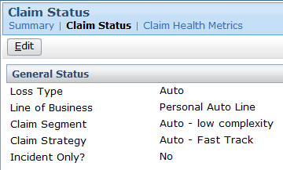
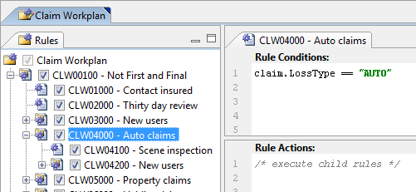
Loss type and LOB code in ClaimCenter
Summary screen: Claim Status
Workplan rules for auto claims
Notes:
Line of Business: Typelists - <number>
The screenshots above show two places where LossType and LOBCode appear and/or change how the application behaves.
The first example is from the Summary screen (Claim Status link) for an auto claim. The claim's loss type and line of business are displayed at the top of the detail view. (Although the screenshot shows only the auto version of Claim Status, all versions of Claim Status in the base application display loss type and LOB code.)
The second example is a claim workplan rule. The rule states that the child rules (Scene inspection and New users) are executed only if the claim's loss type is AUTO (and only if the claim is not a first and final claim).

Slide 8
Policy type
LossType
(&LOBCode)
Auto
Property
Policy
Type
personal
auto
commercial
auto
BOP
(business
owner's)
A product (type of policy) offered by carrier
Notes:
Line of Business: Typelists - <number>
A policy is a product of a line of business that is sold to customers and that promises to pay money when a specified type of loss occurs.
Examples for the Auto loss type:
Commercial auto
Personal auto
LOBCode to PolicyType is M:M (many-to-many).
A line of business (business units at a carrier) can sell many types of policies.
A type of policy can be sold by many lines of business units.
Examples:
Auto (LOB) : Commercial Auto (policy)
Auto (LOB) : Personal Auto (policy)
Property (LOB) : BOP (business owner's policy) (policy)
BOP is a commonly used insurance industry acronym. It stands for Business Owner's Policy.

Slide 9
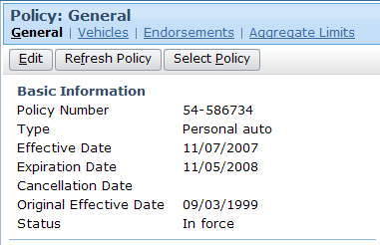
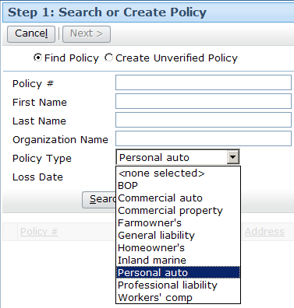
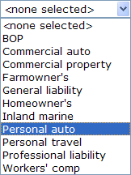
Policy type in ClaimCenter
Claim's policy's policy type
List of all policy types when searching for policy
Notes:
Line of Business: Typelists - <number>
The screenshots above show two places where PolicyType appears and/or change how the application behaves.
The first example is from the Policy - General screen for an auto claim. The policy's type is listed.
The second example is the first step of the New Claim Wizard, where users search for the relevant policy. One of the search criteria is policy type.

Slide 10
Coverage type
LossType
(&LOBCode)
Auto
Property
Policy
Type
personal
auto
commercial
auto
BOP
(business
owner's)
Coverage
Type
compre-hensive
colli-
sion
employee
med. pay
customer
med. pay.
A type of coverage offered on one or more types of policies
Notes:
Line of Business: Typelists - <number>
A coverage is a type of loss included in the policy for which the carrier will compensate the insured.
Examples for Personal Auto policy type: Collision, Comprehensive
Examples for Homeowner's policy type: Earthquake, Flood
Examples for Workers' Comp policy type: Medical, Indemnity (which covers lost wages for time away from work)
PolicyType to CoverageType is M:M (many-to-many).
A type of policy can include many coverages. For example, Commercial Auto includes Collision, Comprehensive, and Medical Payments.
A coverage may be available on more than one policy type. For example, Collision is offered on both personal and commercial auto policy types.

Slide 11
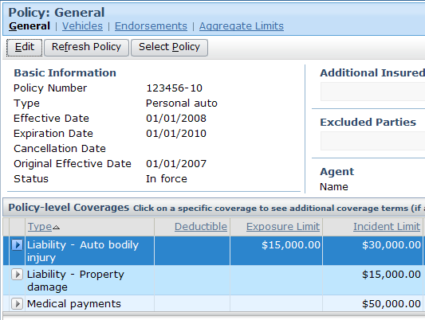
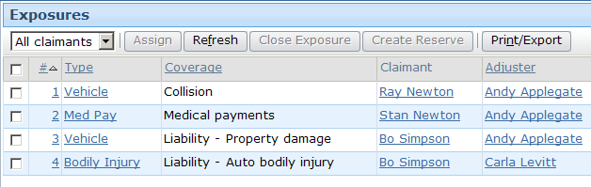
Coverage type in ClaimCenter
Coverage types on claim's policy
Coverage type for
each exposure
Notes:
Line of Business: Typelists - <number>
The screenshots above show two places where CoverageType appears and/or change how the application behaves.
The first example is from the Policy - General screen for an auto claim. The Policy-level Coverages list lists the coverages on the policy. The first column identifies the type of each coverage.
The second example is the list of Exposures on a claim. Recall that an exposure is used to track the money "from" one coverage to one claimant. The Exposures list view lists the coverage type (and claimant) for each exposure.

Slide 12
Exposure type
A set of information to gather for an exposure
  Map to coverage type as many-to-many
LossType
(&LOBCode)
Auto
Policy
Type
personal
auto
commercial
auto
BOP
(business
owner's)
Coverage
Type
liability – property damage
colli-
sion
employee
med. pay
customer
med. pay.
Exposure
Type
property (damage)
vehicle
(damage)
medical
payments
Notes:
Line of Business: Typelists - <number>
During the claims process, an adjuster must gather information about the loss as it pertains to the relevant coverage. Theoretically, ClaimCenter could have a separate detail view for every coverage offered by the carrier. This would be unwieldy, as it is not unusual for a carrier to offer hundreds of coverages across all lines of business.
To simplify the gathering information, ClaimCenter has the concept of an "exposure type". It is a set of information needed during claims processing that relates to one or more similar type of coverages. For example, collision and liability – property damage both cover damage to a vehicle. (Collision covers damage to the insured vehicle from collision with another object. Liability – property damage covers damage to a third-party vehicle.) When a vehicle is damaged, the same sort of information needs to be gathered (what is the extent of damage, was the vehicle towed, is the vehicle a total loss), regardless of which coverage is involved. Therefore, the two coverages are mapped to a single exposure type (vehicle damage), and it is this exposure type which is used to govern the information to gather during the claims process.
CoverageType to ExposureType is M:M (many-to-many).
A coverage type can map to multiple exposure types. (Liability – Property Damage maps to Vehicle Damage (how was vehicle damaged?) and Property Damage (how was non-vehicle property damaged?).
An exposure type can map to multiple coverage types. (Vehicle damage maps to collision and liability – property damage .)
However, the CoverageType-to-ExposureType relationship is implemented unlike all the other relationships . . .

Slide 13
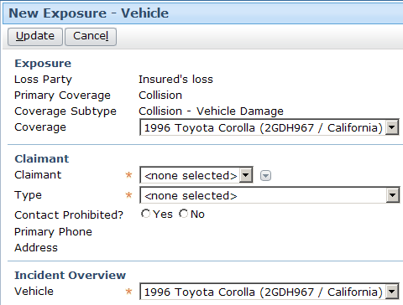
Exposure type in ClaimCenter
Exposure type during new exposure creation
Exposure type for
each exposure
Notes:
Line of Business: Typelists - <number>
The screenshots above show two places where ExposureType appears and/or change how the application behaves.
The first example is one of the New Exposure screens. This screen is specific to vehicle (damage) exposures. Note that the exposure type appears in the title bar. The fields on this form could be unique to this exposure type.
The second example is the list of Exposures on a claim. The Exposures list view lists the exposure type for each exposure.

Slide 14
Coverage-to-exposure-type mapping
Some coverages map to a single exposure type in a simple manner
Some coverages map to multiple exposure types
In some cases, a coverage maps to a single exposure type, but the mapping must capture information about the circumstance of the loss
vehicle
(damage)
collision
vehicle
(damage)
liability - property damage
property
(damage)
builder's risk
(limit: $100,000)
construction risk
property
(damage)
installation
(limit: $50,000)
Notes:
Line of Business: Typelists - <number>
In the first example, collision coverage (from an auto policy) maps to the vehicle (damage) exposure type. Whenever a loss is covered by the collision coverage, the adjuster must gather information about the damage done to the vehicle. No other information will ever be relevant to that coverage.
In the second example, "liability - property damage" (for an auto policy) coverage maps to the both the vehicle (damage) and property (damage) exposure types. Whenever a loss is covered by the "liability - property damage" coverage, the adjuster must gather information either about a damaged vehicle or a damaged piece of property. The relevant exposure type depends on what was damaged.
In the third example, construction risk coverage (for an inland marine policy) maps only to the property (damage) exposure. However, the policy outlines two limits for the coverage: a $100,000 limit on builder's risk, and a $50,000 limit on installation. In both cases, the adjuster must gather information about the damaged property, but the financial exposure is different based on the circumstance of the loss.

Slide 15
Coverage subtype maps coverage to exposure
coll:
vehicle
ClaimCenter uses an additional typelist to represent this mapping from coverage type to exposure type, called CoverageSubtype
  Each coverage subtype is a single mapping between one coverage type and one exposure type
vehicle
(damage)
collision
liab - dmg:
vehicle
vehicle
(damage)
liability - property damage
property
(damage)
liab - dmg:
property
builders risk: pd
construction risk
property
(damage)
installation: pd
Notes:
Line of Business: Typelists - <number>

Slide 16
Coverage subtype
LossType
(&LOBCode)
Auto
Policy
Type
personal
auto
commercial
auto
BOP
(business
owner's)
Coverage
Type
liability – property damage
colli-
sion
employee
med. pay
customer
med. pay.
Coverage
Subtype
liab - dmg:
property
liab - dmg:
vehicle
coll:
vehicle
emp:
medpay
cust:
medpay
Exposure
Type
medical
payments
property
vehicle
Notes:
Line of Business: Typelists - <number>
A coverage subtype is a pair consisting of one coverage type and one exposure type. It breaks down the M:M (many-to-many) relationship between CoverageType and ExposureType into two 1:M (one-to-many) relationships. Because it is establishing a valid coverage/exposure pair, a coverage subtype must have exactly one parent (one coverage) and one child (one exposure).
Why Is This Level Needed?
The coverage subtype level is needed for coverages which are "complex". A coverage is complex when the exposure created from the coverage needs to specify not only what information to gather (the exposure type) but also the circumstance of the loss (coverage subtype). For example, construction risk coverage (for an inland marine policy) could have two limits for the coverage: a $100,000 limit on builder's risk, and a $50,000 limit on installation. The exposure type is used to specify that information must be gathered about damaged property. The coverage subtype is used to determine which limit is relevant. Note that there is nothing on the coverage subtype itself that provides this functionality – Gosu functions can check the exposure.CoverageSubType field before taking actions.

Slide 17
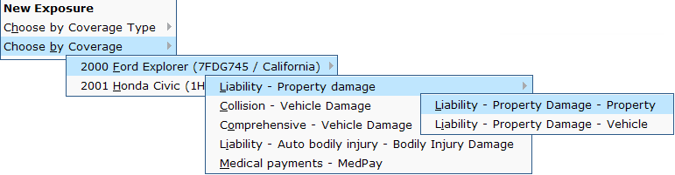
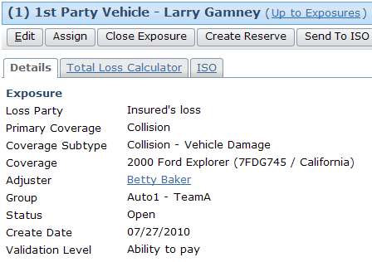
Coverage subtype in ClaimCenter
Coverages during exposure creation
Coverage subtypes during exposure creation
Coverage subtype for existing exposure
Notes:
Line of Business: Typelists - <number>
The screenshots above show two places where CoverageSubtype appear and/or change how the application behaves.
The first example is from the New Exposure menu. It is used during exposure creation. In the series of cascading menus, we can see that the user has decided to choose an exposure "by coverage," which means that they are selecting from a list of coverages that are on the current policy. The current policy has two vehicles on it, a 2000 Ford Explorer and a 2001 Honda Civic. The current claim involves the Explorer, so the user has selected that vehicle. There appear to be five coverages on the vehicle. Only one of the coverages (Liability – Property Damage) has more than one coverage subtype, which is why that coverage has an additional menu. The user is selecting the Liability – Property Damage – Property coverage subtype.
The second example is the detail view for an existing exposure. The (primary) coverage and coverage subtype are listed.

Slide 18


System which "determines" each level
LossType
(&LOBCode)
Auto
Policy
Type
personal
auto
commercial
auto
Policy
Admin
System
Coverage
Type
compre-hensive
colli-
sion
employee
med. pay
Coverage
Subtype
Exposure
Type
theft
vehicle
Notes:
Line of Business: Typelists - <number>
Information about the LossType, LOBCode, PolicyType, CoverageType and CoverageSubtype is ultimately determined by the policy administration system (PAS). ClaimCenter has information local to itself about the structure of a policy, but this information is designed to map to what is stored in the PAS so that when policies are retrieved from the PAS, ClaimCenter knows how to interpret them.
Information about ExposureType is unique to ClaimCenter. ExposureType is a mechanism used to streamline the gathering of information about a loss. Therefore, there is no analog to exposure type in the PAS.

Slide 19
Line of business levels: Review
LossType
(&LOBCode)
Auto
Property
Policy
Type
personal
auto
commercial
auto
BOP
(business
owner's)
Coverage
Type
compre-hensive
colli-
sion
employee
med. pay
customer
med. pay.
Coverage
Subtype
Exposure
Type
medical
payments
theft
vehicle
Notes:
Line of Business: Typelists - <number>

Slide 20
Lesson outline
Line of business model
The LOB typelists
The LOB editor
LOB model configuration
Notes:
Line of Business: Typelists - <number>

Slide 21
The LOB model typelists
ClaimCenter manages LOB model through series of six interconnected typelists
  Typecodes in each typelist reference typecodes in the typelists above and below it
  For example, "personal auto" policy typecode references one LOB code ("auto") and eighteen coverage typecodes (such as "collision")
LossType
LOBCode
PolicyType
CoverageType
CoverageSubtype
ExposureType
Notes:
Line of Business: Typelists - <number>
All the typelists seen so far with parent/child relationships have the relationship specified in one direction. In other words, the child list references the parent list, but the parent list does not reference the child list.
The LOB typelists behave differently. Within the LOB model, whenever a parent typecode refers to a child typecode, the child typecode must also refer to the parent typecode. Fortunately, the LOB editor automatically ensures that a given parent/child relationship is identified in both lists in the underlying XML files. This relationship is almost transparent to the developer.

Slide 22
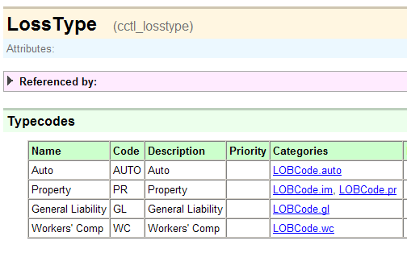
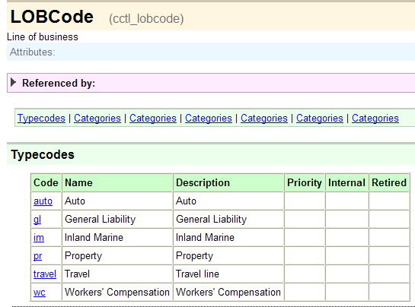
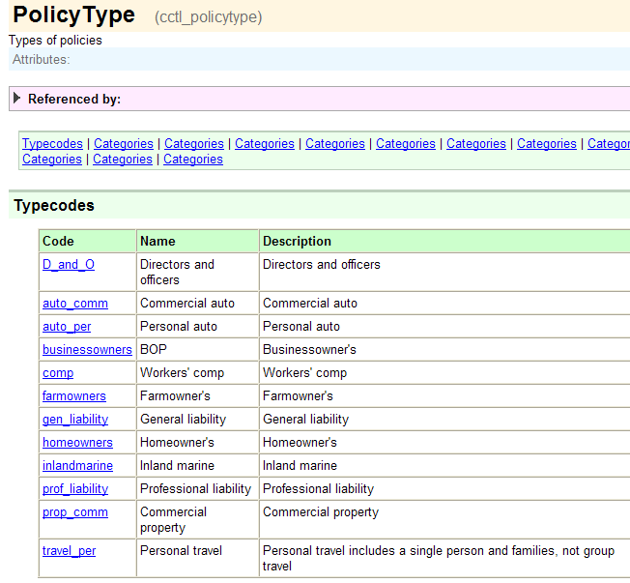
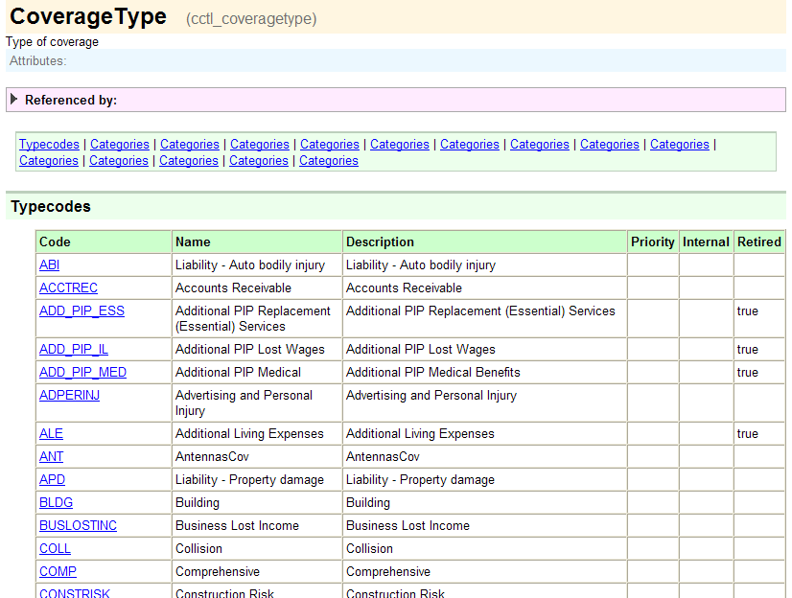
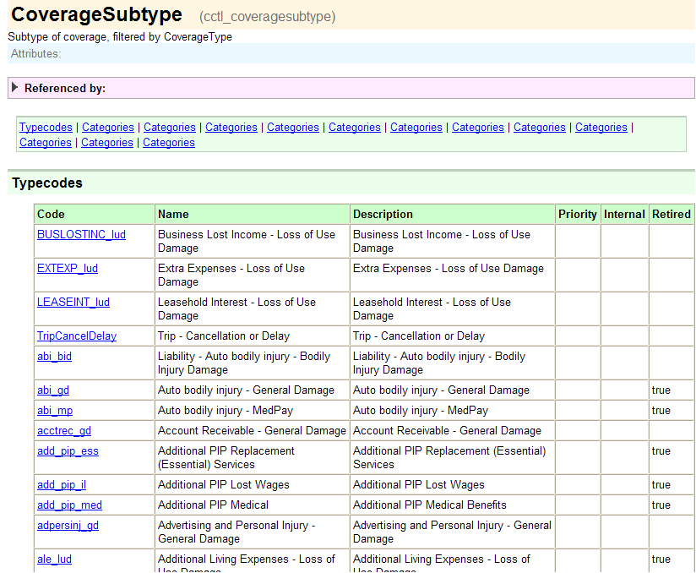
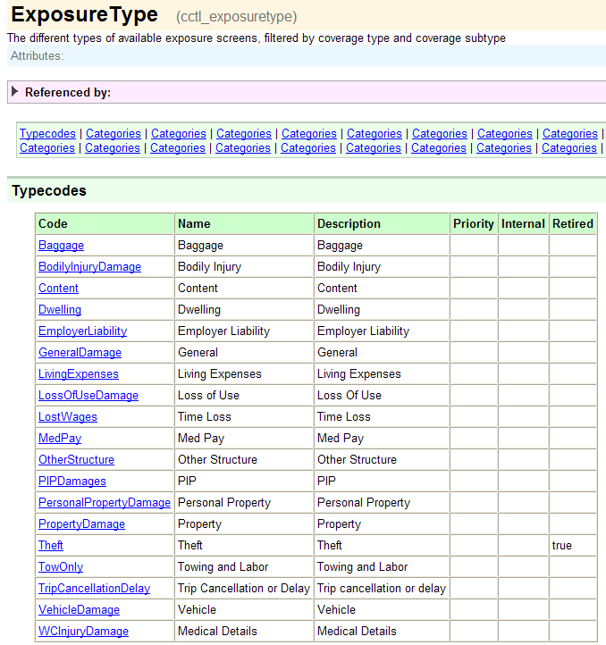
LOB typelists
Notes:
Line of Business: Typelists - <number>
The six LOB typelists from the data dictionary are shown above. If you view the typelists in the data dictionary, you will notice that each one of them makes heavy use of the Categories column. This is because each typecode is relevant only in a limited number of circumstances. (For example, the "Collision" typecode is relevant only when the policy type is "commercial auto" or "personal auto".)

Slide 23
Typelists external to LOB model
ClaimantType
LossCause
MetroReportType
OfficialType
PriContributingFactors*
QuickClaimDefault
ResolutionType
SeverityType
LossType
LOBCode
InternalPolicyType
PolicyTab
InsuranceLine*
PolicyType
CostCategory
LineCategory
CoverageType
LossPartyType*
CoverageSubtype
ExposureType
Incident
Notes:
Line of Business: Typelists - <number>
The six typelists that comprise the LOB model are not isolated from the ClaimCenter data model. Typecodes in other typelists reference typecodes in the six LOB typelists, and in some cases typecodes in the LOB typelists reference typecodes in non-LOB typelists. For example, the InsuranceLine typelist is used for stat reporting. It has typecodes (such as "glass") which reference typecodes in the PolicyType typelist (such as "auto_commercial" and "auto_personal"). Similarly, typecodes in PolicyType (such as "personal auto") reference typecodes in InternalPolicyType (such as "personal").
Consequently, when you make changes to typelists within the LOB model, you may also need to add, remove, or modify typecodes in typelists outside of the LOB model. All of typelists in the base application which directly reference or are referenced by an LOB typelist are listed in the diagram above.
*Be aware that there are some instances of cascading references across three or more typelists. For example:
LossType is referenced by PriContributingFactors, which is referenced by SecContributingFactors, which is referenced by ResContributingFactors
PolicyLine is referenced by InsuranceLine, which is referenced by both InsuranceSubline and MajorPerils
CoverageSubtype is referenced by LossPartyType, which is referenced by VehicleType
In these cases, a change to one LOB typelists could require changes to a non-LOB typelist, which in turn requires changes to another non-LOB typelist.

Slide 24
Common LOB model configurations
Adding new entries
  Example: Adding "umbrella" policy
Retiring existing entries
  Example: Obsolescing "pollution" coverage
Connecting two entries
  Example: Associating "spoilage" coverage with the "homeowner's" policy
Disconnecting two entries
  Example: Disassociating "watercraft liability" coverage from "personal auto" policy
Notes:
Line of Business: Typelists - <number>
Removing a line of business from the base application's LOB model is a daunting task that is not recommended. Retirement of the line achieves the same objective AND allows for access of any existing data in that line.

Slide 25
Lesson outline
Line of business model
The LOB typelists
The LOB editor
LOB model configuration
Notes:
Line of Business: Typelists - <number>

Slide 26
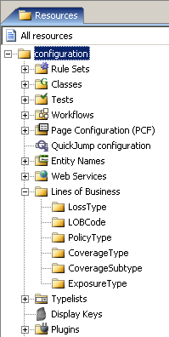
LOB editor
LOB editor is Studio resource which is used to configure LOB model
  Contains all six typelists in model-appropriate order
  These typelists do not appear in Typelists editor
LossType
LOBCode
PolicyType
CoverageType
CoverageSubtype
ExposureType
Notes:
Line of Business: Typelists - <number>

Slide 27
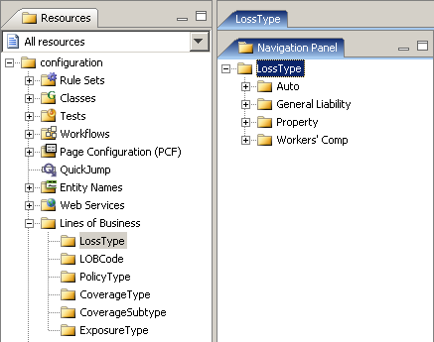
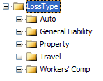
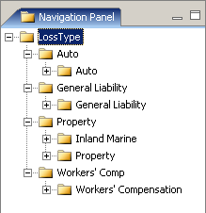
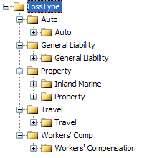
Selecting a LOB typelist
Loss type expanded to show LOB codes
Loss types
(with no children showing)
When you select LOB typelist, its typecodes are displayed in navigation panel
  You can also expand any non-terminal node
Notes:
Line of Business: Typelists - <number>

Slide 28
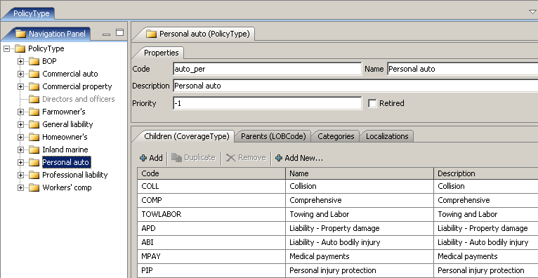
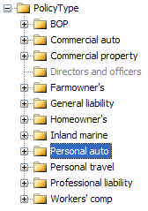
Viewing LOB typecode information
When you select typecode, right pane displays:
  Its code, name, description and priority
  All its children and parents (on separate tabs)
Notes:
Line of Business: Typelists - <number>

Slide 29
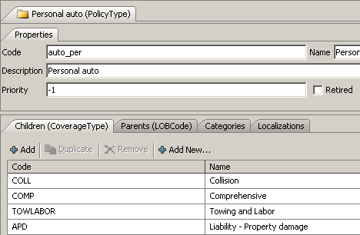
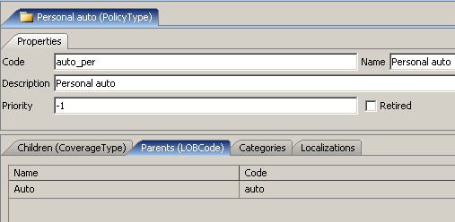
Children and parent codes
For given code, you can:
  View and edit associations to child codes
  View associations to parent codes
Notes:
Line of Business: Typelists - <number>
To edit association to parent codes, you must go to the parent list. (For example, to change the fact that the Personal auto policy type maps to the Auto LOBCode, you would need to go to the LOBCode list.

Slide 30
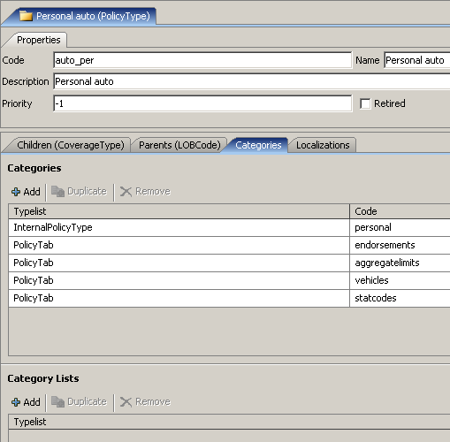
Category and localization
Each code has additional tabs for specifying categories (associations to additional non-LOB typelists) and localization information
InternalPolicyType
PolicyTab
PolicyType
Notes:
Line of Business: Typelists - <number>
An example of the Localization tab appears below (which is visible if you view PowerPoint in Notes view (View | Notes Page)).

Slide 31
Lesson outline
Line of business model
The LOB typelists
The LOB editor
LOB model configuration
Notes:
Line of Business: Typelists - <number>

Slide 32
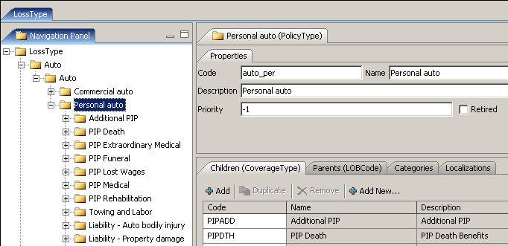
Editing codes
  To modify a code, select it and make the appropriate changes in the right pane
Notes:
Line of Business: Typelists - <number>

Slide 33
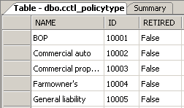
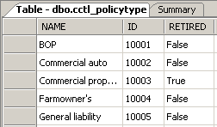
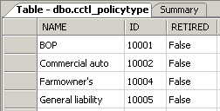


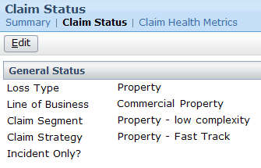
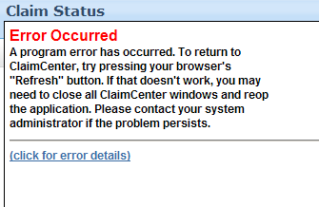
Removing codes from LOB model
Active
Retired
Deleted
Database
New
Objects
Existing
Objects
Notes:
Line of Business: Typelists - <number>
There are two ways to remove a code from the LOB Model: retiring and deleting.
When a code is retired, it cannot be chosen in any dropdowns for new objects or for existing objects that are being edited. However, the value does display for any existing record which uses the object. (In the example above, Commercial property has been retired. It cannot be selected from any dropdown, but it still appears as the policy type for any policy which was of type Commercial Property at the time the code was retired.)
When a code is deleted, it is physically removed from the database. Similar to being retired, it cannot be chosen in any dropdowns for new objects or for existing objects that are being edited. However, if there any existing objects which use that typecode, then attempts to display the object will cause an error, as the underlying tables will have a foreign key reference to a row which no longer exists.

Slide 34
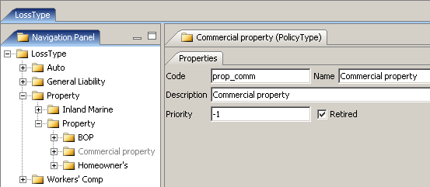
Retiring typecodes
Delete codes only when there is no existing object which references code (such as in development system)
If any existing object references code, you should retire it
  Retired typecodes appear in gray in the navigation panel
Notes:
Line of Business: Typelists - <number>
The recommendation around retiring typecodes (as opposed to deleting them) is not unique to the LOB model. This is a good practice for any typecode that is referenced by existing records.

Slide 35

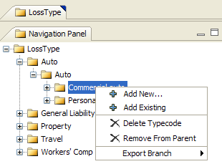

Creating and removing codes and code associations
Commercial auto
existing
typecode
Com
merci
...
Auto
Commercial auto
Notes:
Line of Business: Typelists - <number>
Each node in the navigation panel has a context menu used to modify that node. To display the context menu, right-click the given node.
Add New creates a new typecode and makes it a child of the given typecode.
Add Existing associates an existing typecode as a child to the given typecode.
Delete Typecode entirely deletes the typecode from the LOB Model. Any child typecodes will no longer have the given typecode as a parent. Any child typecodes which had only the given typecode as a parent become orphan typecodes. In a production environment, codes should be deleted with extreme caution, as problems will arise if any existing object references the code. In a production environment, retiring codes is recommended.
Remove From Parent deletes the association between the given typecode and its parent, but the given typecode is not deleted and it retains all of its child relationships. This option is available only when you select a child node within the given tree structure. For example, the screenshot above shows Loss Types (Auto, General Liability, Property, and Workers' Comp). If you right-click on the Auto loss type node, you will not see a Remove From Parent option. This is because the code could have multiple parents and, given the context, Studio cannot infer which parent/child association you would want to remove. The screenshot also shows the Auto loss type node expended, and the Auto LOB code beneath it. If you select the Auto LOB code, you do get a Remove From Parent option. This is because Studio can infer that the association to remove is Auto (loss type) to Auto (LOB).
10-Dec-07 Page <number>

Slide 36

Referential integrity within the LOB model
Whenever you modify LOB association at one level, LOB editor automatically makes reciprocal association
LossType
developer makes Contents a child of internat_BOP...
LOBCode
PolicyType
...and Studio makes internat_BOP a parent of Contents
CoverageType
CoverageSubtype
ExposureType
Notes:
Line of Business: Typelists - <number>

Slide 37
Referential integrity beyond LOB model
Associations between LOB typelists and non-LOB typelists must be maintained manually
LossType
LOBCode
InsuranceLine
PolicyType
InternalPolicyType
PolicyTab
CoverageType
Developer adds international_
BOP policy type...
...and modifies references in InsuranceType, InternalPolicyType and PolicyTab
CoverageSubtype
ExposureType
Notes:
Line of Business: Typelists - <number>
Modification to typelists outside of the LOB Model are done using the typelist editor.

Slide 38
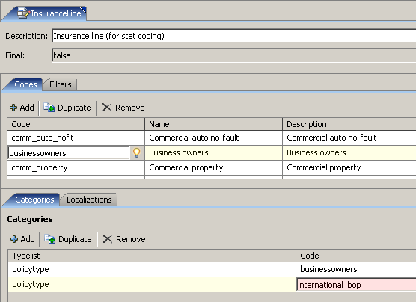
Referential integrity beyond LOB model: example
InsuranceLine
PolicyType
Notes:
Line of Business: Typelists - <number>
The scenario shown in the previous slide is one in which the developer has added a new policy type (international_bop). He or she must manually manage references to it in typelists external to the LOB editor.
The screenshot above shows the InsuranceLine typelist, a typelist used for stat coding. Because a new policy type has been added, each InsuranceLine stat code which must reference it must be modified. The screenshot shows the InsuranceLine value of "businessowners" being associated to the new "international_bop" policy line.

Slide 39
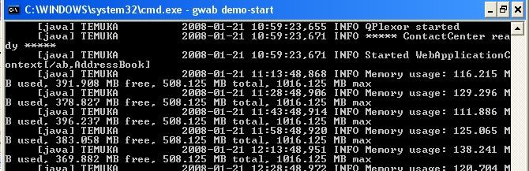
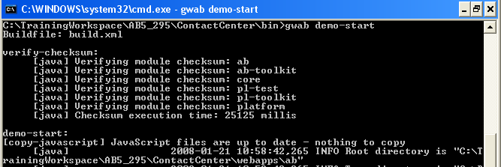
Deploying line of business changes
Recall that LOB model is stored in typelists
  Whenever you modify typelist information, you must stop and restart the server to deploy the information
Notes:
Line of Business: Typelists - <number>

Slide 40
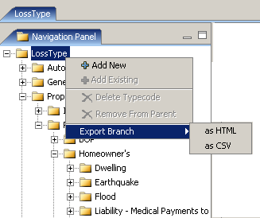
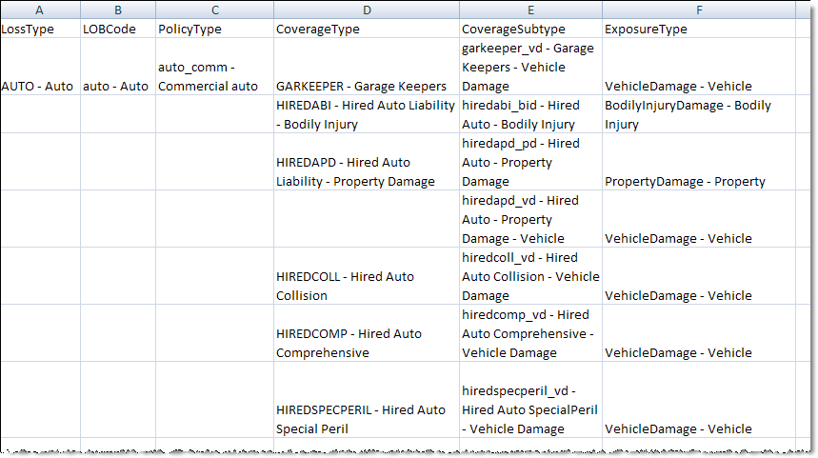
Exporting LOB model data
You can export LOB model (or any portion of it) into HTML or CSV file
Notes:
Line of Business: Typelists - <number>
10-Dec-07 Page <number>

Slide 41
Lesson objectives review
You should now be able to:
  Describe the purpose of the Line of Business model
  Describe how the LOB typelists define the LOB model
  Describe the functionality of the LOB editor
  Configure LOB typelists
Notes:
Line of Business: Typelists - <number>

Slide 42
Review questions
What is the difference between the LossType and LOBCode typelists?
What is the primary purpose of an ExposureType? Name an exposure type which could map to multiple coverages.
Typecodes at one LOB level can have only one parent and only one child. Which level is it? Why is this true?
Where would you go in the LOB editor to associate an existing policy type of "BOP" to an existing coverage of "Directors and Officers"?
When you retire or delete a typecode:
  Can new objects use the value?
  Can existing objects that use the value be displayed?
Notes:
Line of Business: Typelists - <number>
Answers
1. LossType and LOBCode both classify the type of loss at a high level. They are nearly identical, with LOBCode offering a second, more granular level of loss classification for reporting purposes. In practice, most customers map each LossType to a single LOBCode.
2. An ExposureType is a set of information used to create an exposure. For example, a "vehicle" exposure type could be used for exposures which are tied to a "collision" coverage or a "liability - vehicle damage" coverage, because both coverages require information about the way in which a given vehicle was damaged.
3. CoverageSubtype. This is because CoverageSubtype's purpose is to break down the many-to-many relationship between CoverageType and ExposureType into two many-to-one relationships.
4. You would go to the PolicyType typelist, right-click the BOP node, choose Add Existing and select the "Directors and Officers" coverage.
5. a) In both cases, no.
b) If the code is retired, yes. If the code is deleted, no, you will get an error if you attempt to display the object.

Slide 43
Notices
Copyright © 2001-2011 Guidewire Software, Inc. All Rights Reserved.
Guidewire, Guidewire Software, Guidewire ClaimCenter, Guidewire PolicyCenter, Guidewire BillingCenter, Guidewire Reinsurance Management, Guidewire ContactManager, Guidewire Vendor Data Management, Guidewire Client Data Management, Guidewire InsuranceSuite, Guidewire ContactCenter, Guidewire Studio, Gosu, Deliver Insurance Your Way, and the Guidewire logo are trademarks or registered trademarks of Guidewire Software, Inc. in the United States and/or other countries.
This material is Guidewire proprietary and confidential. The contents of this material, including product architecture details and APIs, are considered confidential and are fully protected by customer licensing confidentiality agreements and signed Non-Disclosure Agreements (NDAs).
This file and the contents herein are the property of Guidewire Software, Inc. Use of this course material is restricted to students officially registered in this specific Guidewire-instructed course, or for other use expressly authorized by Guidewire. Replication or distribution of this course material in electronic, paper, or other format is prohibited without express permission from Guidewire.
    Guidewire products are protected by one or more of the following patents: U.S. Patent No. 7,885,831; U.S. Patent No. 7,788,296.
Notes:
Introduction to Guidewire Configuration - <number>

